Slide 1

King County Housing Data Regression Project
Johnny Dryman

Slide 2
Overview
This project was designed to analyze home and property value in King County (Seattle, WA area)
Data was obtained from King County home sales between May 2014 – May 2015
Questions:
What quantities and / or qualities are most influential in determining sale price?
How can a resident of King County increase the value of their home?

Slide 3
Data
Used
Sale Price
# Floors
Living Area Square Footage
Lot Square Footage
Waterfront (Y/N)
Condition
Year Built
Zip Code
Basement (Y/N)
Renovated (Y/N)
Not Used
Sale Date
# Bedrooms
# Bathrooms
View
Grade
Basement Square Footage
Non-Basement Square Footage
Year Renovated
Latitude
Longitude
Living Square Footage – 15 Nearest Neighbors
Lot Square Footage – 15 Nearest Neighbors

Slide 4
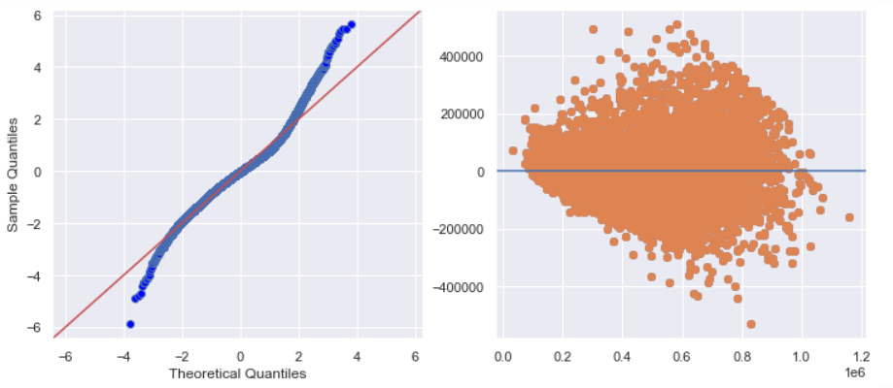
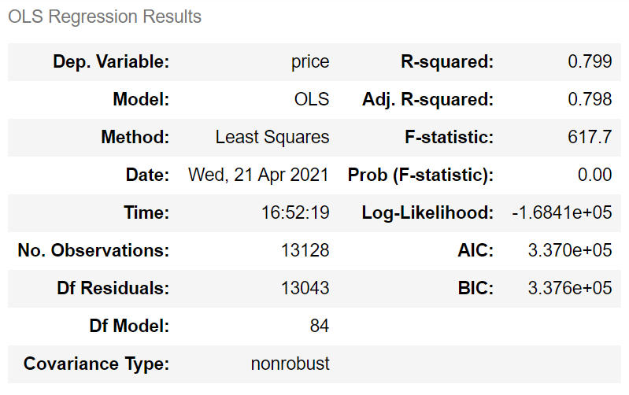
Regression Model

Slide 5
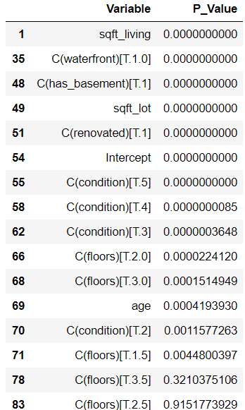
Findings
Primary Price Drivers
Living Area Square Footage - $159 / sqft
Zip Codes - top 5 add $473-628k
Waterfront - $338k
Lot Square Footage - $3.45 / sqft
Basement - $23,634 penalty
Renovated - 42,260 bonus
Condition – between $0 and $174k
Less Significant Features
# Floors – penalty or bonus vary
Age - $168 penalty per year

Slide 6
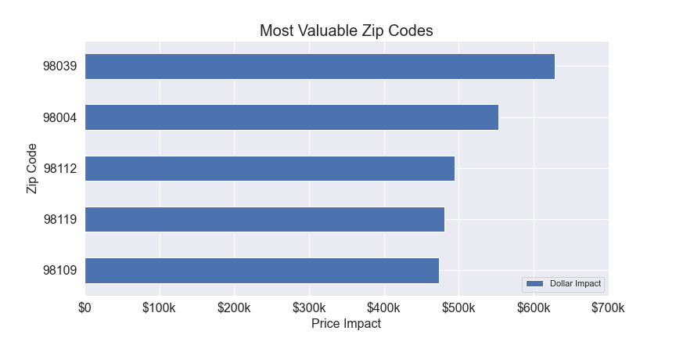
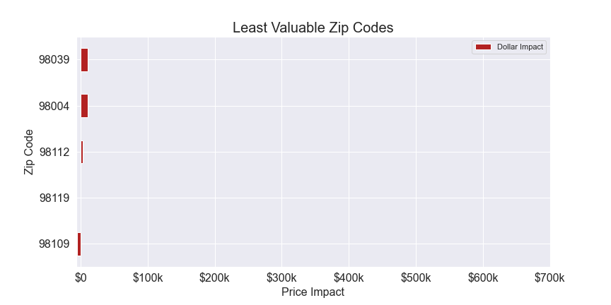
Zip Codes Most / Least Valuable
Top 5 Zip Codes
Add $473-628k to value
Located in metro area (Seattle, Bellevue, Mercer Island)
Closer to water
Bottom 5 Zip Codes
Range from $5k penalty to $10k bonus
Located in southern King County, Kent area
Landlocked

Slide 7
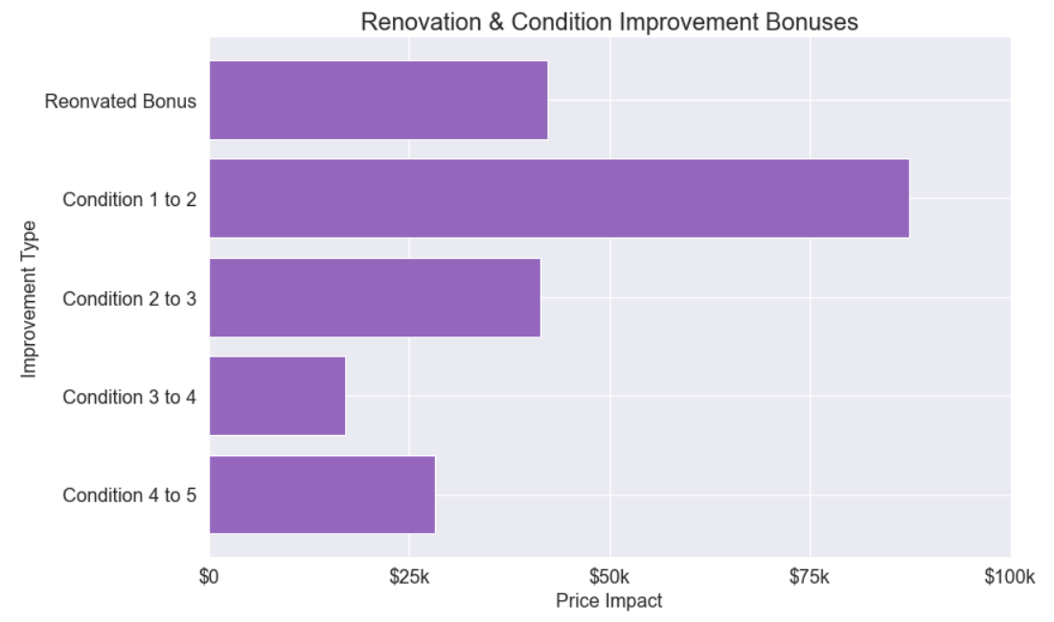
Recommendation: Renovate and Improve / Maintain Condition
Renovating to improve condition will provide $42k bonus
If the renovation improves the condition, additional bonus will be applied
Condition 1 to 2: + $87,360
Condition 2 to 3: + $41,455
Condition 3 to 4: + $17,031
Condition 4 to 5: + $28,288
Invest in regular maintenance to avoid condition deterioration penalty

Slide 8
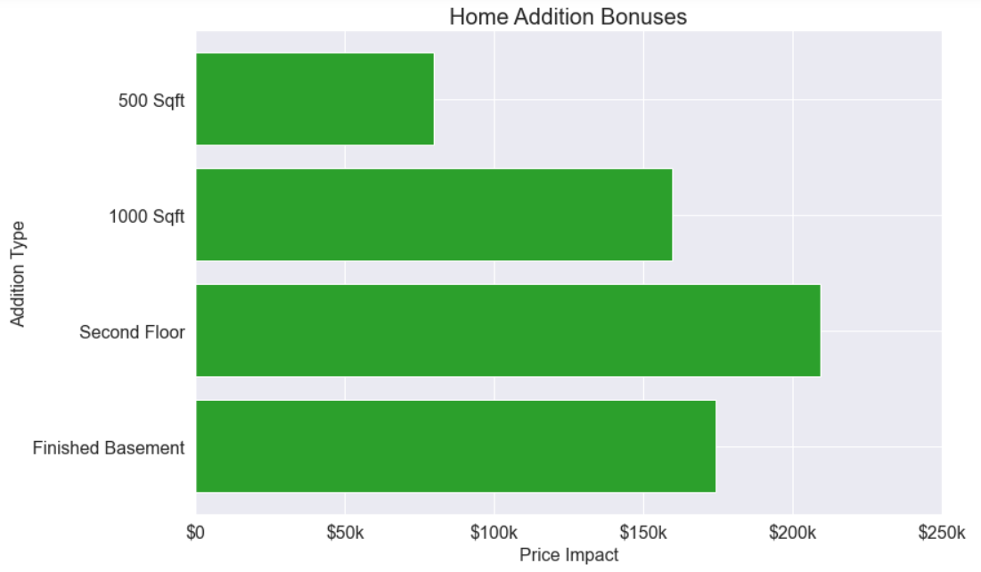
Recommendation: Add Living Square Footage through Construction
Each additional square foot will add $159 to the home value
500 sqft: $79,740
1000 sqft: $159,480
Building a second floor (approx. 1240 sqft)
1240 sqft: $197,755
2nd floor bonus: $11,448
Total: $209,204
Finishing a basement:
1240 sqft: $197,755
Basement penalty: (-) $23,634
Total: $174,121

Slide 9
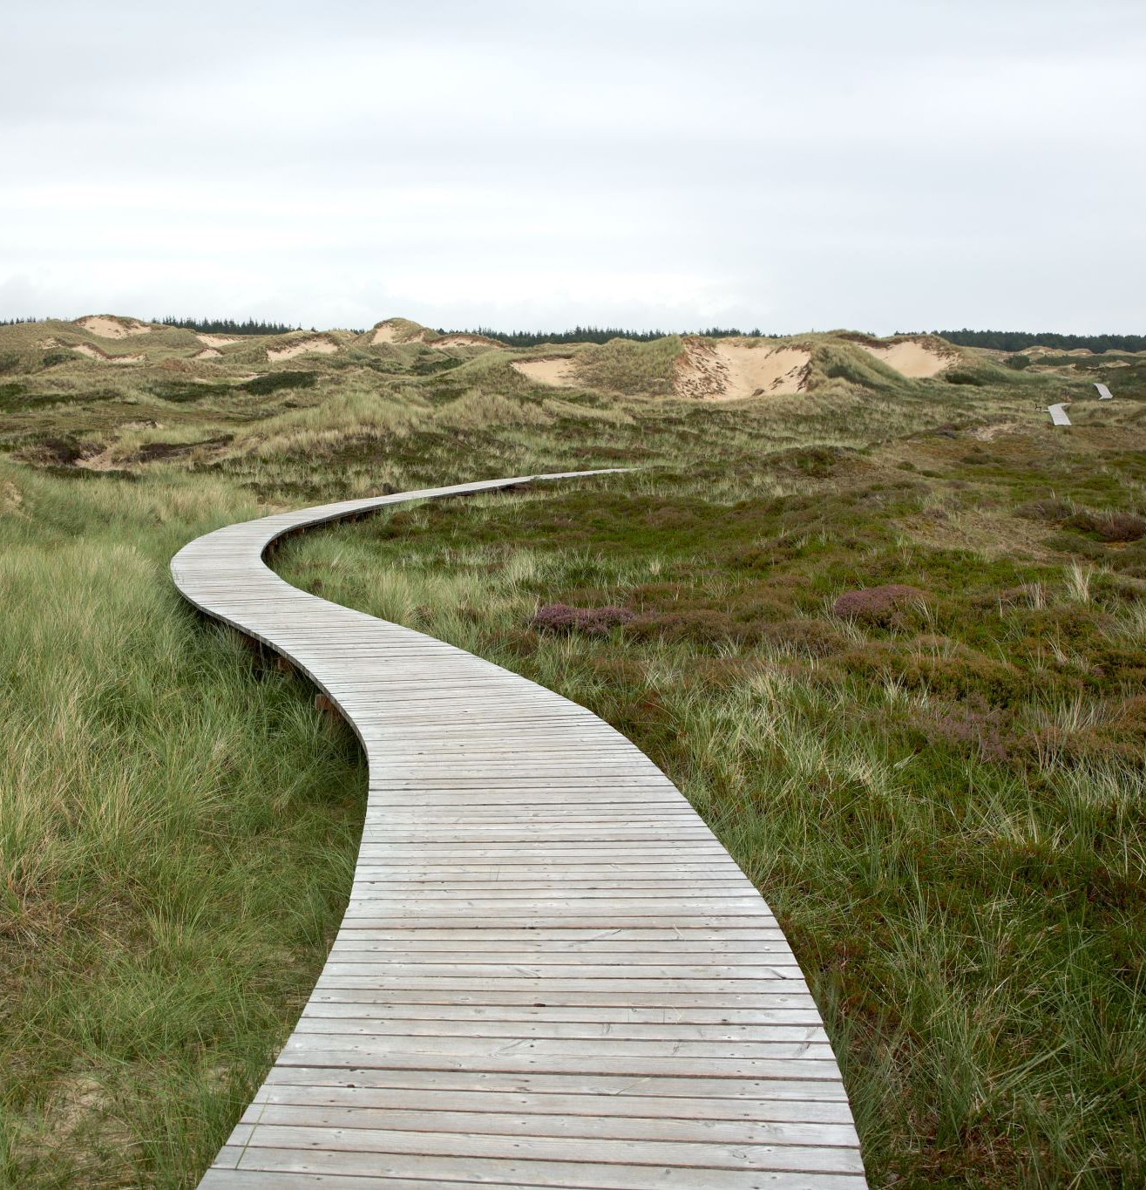
Next Steps
Implement Latitude, Longitude, Year Renovated, and Living & Lot Square Footage for closest 15 neighbors
Develop heatmap to refine geographic understanding
Normalize features to improve predictive quality
Create dynamic splitting functionality to run model on filtered datasets
Example: how specifically could the owner of a 2 story, 4 bedroom house in Bellevue improve their home value?

